Slide 1
T-model
SPECTRION TECHNOLOGIES
Sigma005
Diversification is the only free lunch
Date: 28 September 2017
Modelled by: Langyu Gu

Slide 2
Not to be smart, but to be diversified
As an asset manager, our goal is to deliver stable and positive returns consistently regardless market conditions. In a market crisis, the traditional assets tend to be highly correlated, the diversification benefit of traditional assets is limited, which results in portfolio exposing to excessive risk and losses. Therefore, the task of seeking diversification or reducing portfolio correlations has become essential, which I think is more important than seeking new alpha opportunities.
Throughout the past three decades, asset managers actually have been seeking diversification all the time. We have seen a path of investing in Emerging market equity in 1990s, popularity of Alternatives (Private Equity, Commodities, Real Estates) in 2000s and to lately smart factor investing.
Regional diversification
1990s
Asset Class diversification
2000s
Style
diversification
2010s
However, when a diversification becomes popular, crowded investing diminishes its benefit and it becomes no longer profitable. For instance, correlations between traditional assets, including emerging markets, have been rising for the past decades.
The spirit of Technical model is to seek diversification throughout the construction. We aim to maximise diversification benefit from all aspects.

Slide 3
Structure
Carry X
EMA X
IR X
Carry Y
EMA Y
IR Y
Carry Z
EMA Z
IR Z
Carry Weight X
EMA Weight X
IR Weight X
Carry Weight Y
EMA Weight Y
IR Weight Y
Carry Weight Z
EMA Weight Z
IR Weight Z
Combined signal: X
Combined signal: Y
Combined signal: Z
Weight X
Weight Y
Weight Z
Technical Model Portfolio

Slide 4
Factor construction
There is not a single strategy would make money forever. Momentum strategy works in trending market but mean-reversion strategy works when a factor has gone too extreme. The combination of momentum and mean-reversion strategies, empirically, produces better performance over individual one of them.
All type of strategy signals can be split into 6 categories:
Short-term Momentum | Medium-term Momentum | Long-term Momentum
Short-term Mean-reversion | Medium-term Mean-reversion | Long-term Mean-reversion
Momentum strategy:
Stop-loss system
Positive skew
Mean-reversion strategy:
Catch falling knives
Negative skew
Short Term Mean-reversion
Medium Term Momentum
Long Term Mean-Reversion

Slide 5
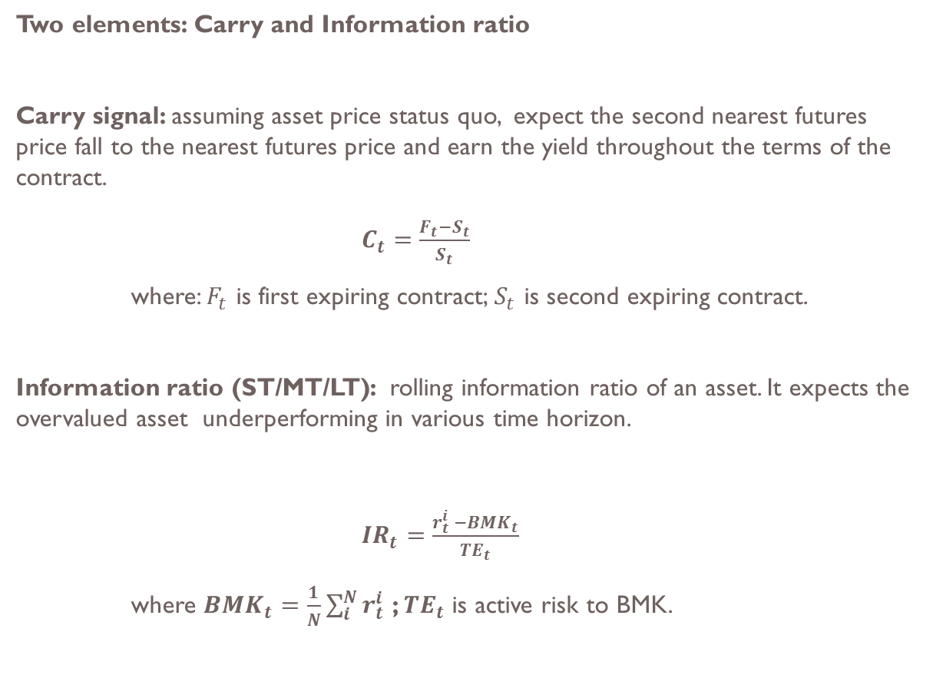
Factor constructions – Mean reversion
Two elements: Carry and Information ratio
Carry signal: assuming asset price status quo, expect the second nearest futures price fall to the nearest futures price and earn the yield throughout the terms of the contract.
$C_{t}=\frac{F_{t}−S_{t}}{S_{t}}$
where: $F_{t}$ is first expiring contract; $S_{t}$ is second expiring contract.
Information ratio (ST/MT/LT): rolling information ratio of an asset. It expects the overvalued asset underperforming in various time horizon.
${IR}_{t}=\frac{r_{t}^{i} −{BMK}_{t}}{{TE}_{t}}$
where ${BMK}_{t}=\frac{1}{N}\sum_{i}^{N}{r_{t}^{i}}$ ; ${TE}_{t}$ is active risk to BMK.

Slide 6
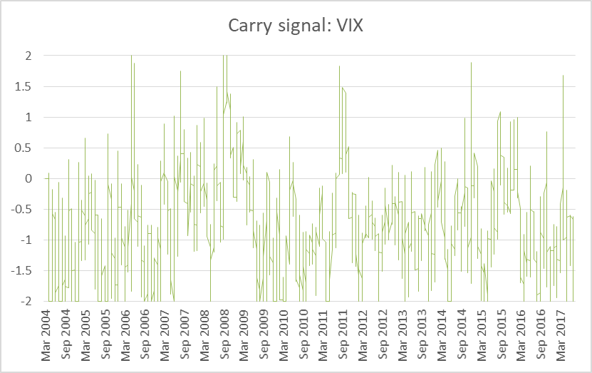
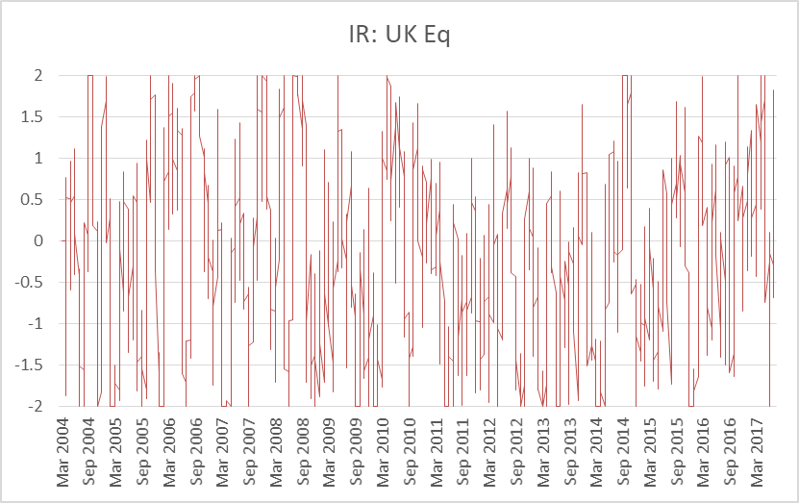
Factor constructions – Mean reversion
Carry signal of VIX
IR signal of UKX

Slide 7
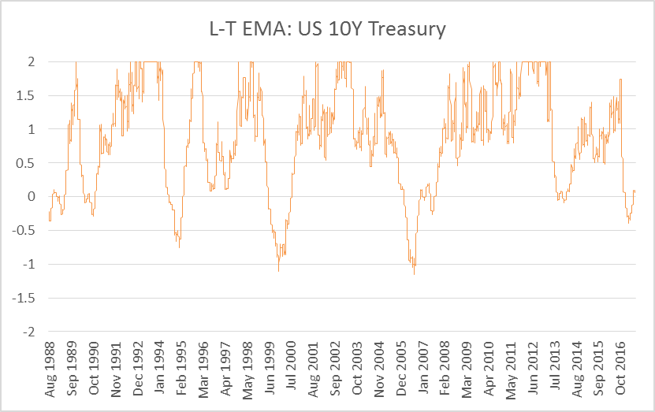
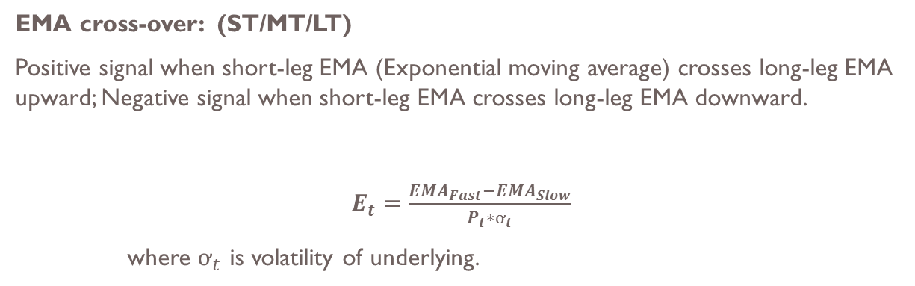
Factor constructions – Momentum
EMA cross-over: (ST/MT/LT)
Positive signal when short-leg EMA (Exponential moving average) crosses long-leg EMA upward; Negative signal when short-leg EMA crosses long-leg EMA downward.
$E_{t}=\frac{{EMA}_{Fast}−{EMA}_{Slow}}{P_{t}∗ơ_{t}}$
where $ơ_{t}$ is volatility of underlying.

Slide 8
Dynamic tuning engine
A good set of variations(parameters) should work well on various instruments. It is especially true for price based strategies. It is also the best way to avoid overfitting by stopping individually tailoring rule for every instrument.
Hence, the “core” set of parameters is defined by the best sharp ratio across all instruments. And all market conditions. Fixed income instruments and Equity instruments behave fundamentally different, therefore the core parameters are analysed in separate groups.
In the system, to find the second and third sets of parameters does not rely on the performance or sharpe ratio. Instead, the correlation is the key selection criteria. It is because of that:
(1) It is very difficult to significantly prove that one set of rules outperforms the others.
(2) expected low correlated strategies provide diversification benefit.
The table shows the number of years required to be significant that one strategy is better than another
Correlation between strategies
Sharpe Ratio advantage
0.1
0.25
0.5
-1.0 | 0.0 | 0.5 | 0.8 | 0.95
47 | 47 | 46 | 44 | 37
46 | 45 | 40 | 32 | 10
41 | 37 | 25 | 10 | 3
Source: Systematic Trading

Slide 9
Structure
Carry X
EMA X
IR X
Carry Y
EMA Y
IR Y
Carry Z
EMA Z
IR Z
Carry Weight X
EMA Weight X
IR Weight X
Carry Weight Y
EMA Weight Y
IR Weight Y
Carry Weight Z
EMA Weight Z
IR Weight Z
Combined signal: X
Combined signal: Y
Combined signal: Z
Weight X
Weight Y
Weight Z
Technical Model Portfolio

Slide 10
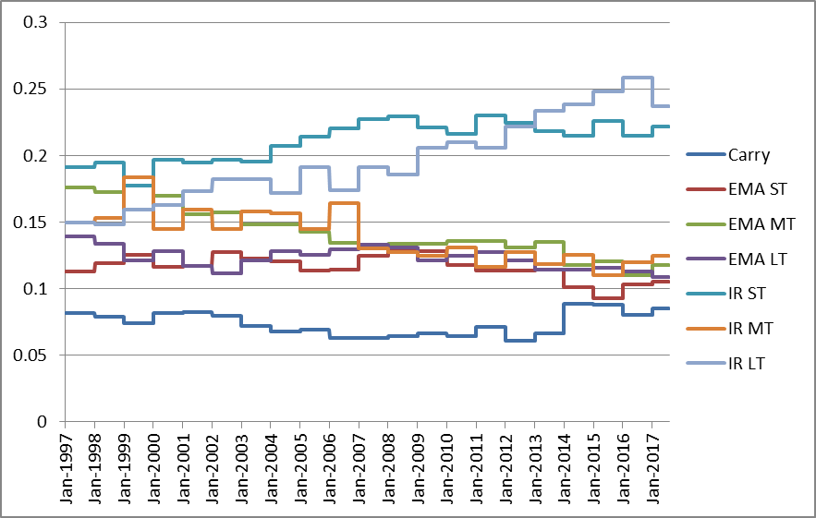
Combining signals
Maximum sharpe ratio optimisation (similar to Mean variance optimisation) gives the most diversified portfolio. It is the way to seek estimated weights among sub-strategies and construct the final signal for an instrument.
US Eq: Dynamic weights of sub-strategies
US Eq: Average correlation between sub-strategies
Chart of Sharp ratio signal
Chart of EMA-CO signal

Slide 11
To avoid overfitting
The big problem with strategy construction is that the model is easily get overfitted, after all sorts of optimisation, parameter tuning etc. Model is considered overfitted when it only works for the past in a particular market environment but it works poorly in more general market.
Overfitting is the biggest “criminal” in the finance field. All hard works and analysis could be “wasted” if a model is overfitted/overanalysed.
Several quantitative techniques to avoid overfitting:
Monte Carlo simulation
Cross validation
Simple bootstrapping
Complex bootstrapping
Preserve detailed characteristic of an instrument/strategy
Generate >10,000 simulations
Include all types of market environments
Pitfall: a few of simulated time series might be unrealistic

Slide 12
Trading cost as a vital factor
Actual return = market return – (trading cost + commission).
We try hard to estimate the market return and often fail to do so. Cost, however, is generally certain and easier to predict. In certain instrument or strategy, costs could be the “deal breaker” even the strategy looks amazing before costs. It is especially true for high frequency strategies.
T-model has considered trading costs seriously and the costs are involved in every part of analysis and simulations.
Annualised turnover and cost in Sharpe Ratio term in the simulated back-test based on a $100m portfolio.

Slide 13
Correlation: Before and After
Correlation between assets are more independent than before.

Slide 14
Structure
Carry X
EMA X
IR X
Carry Y
EMA Y
IR Y
Carry Z
EMA Z
IR Z
Carry Weight X
EMA Weight X
IR Weight X
Carry Weight Y
EMA Weight Y
IR Weight Y
Carry Weight Z
EMA Weight Z
IR Weight Z
Combined signal: X
Combined signal: Y
Combined signal: Z
Weight X
Weight Y
Weight Z
Technical Model Portfolio

Slide 15
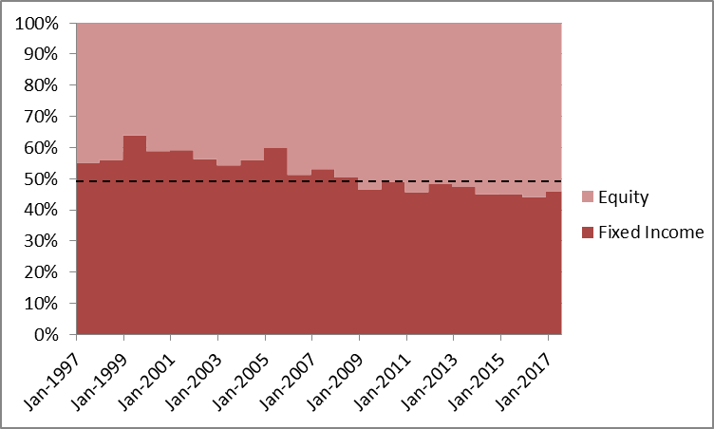
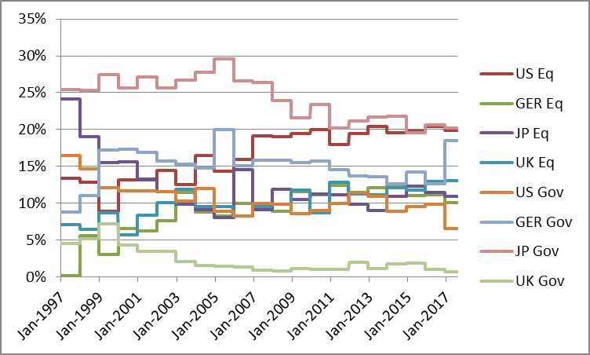
Result - 8 assets model
Estimated weights between Equity and Fixed Income have been switched to more Equity from more Fixed Income. It suggests 50%/50% equal weights, on average, between Equity and Fixed Income.
Given the current optimal weights, US Eq and JP Gov have highest positions of 19.9% and 20.2% respectively.

Slide 16
Result - T model signals as of 20/09/2017
Signal as of 20/09/2017 suggests:
Sell US Equity; Buy German/Japan/UK Equities
Buy German/UK Government bonds

Slide 17
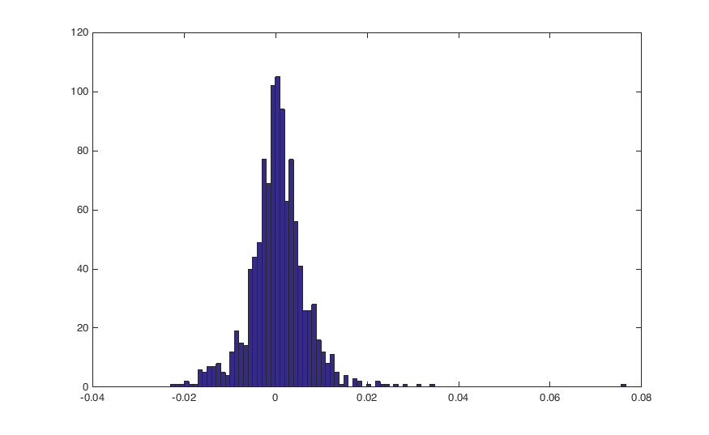
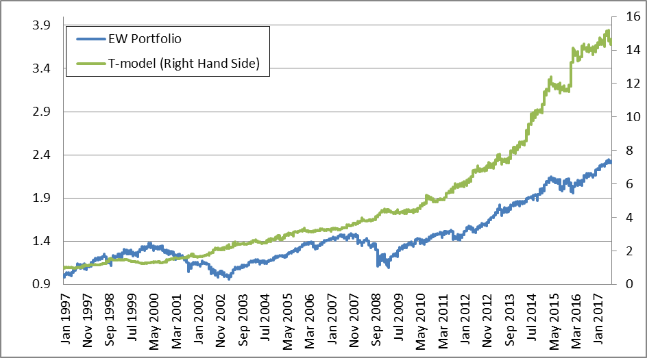
Result – PNL and statistics
T-model vs E.W portfolio:
More than doubled annualised return (APR)
Doubled sharpe ratio (after cost)
Limited drawdown to 20.6%
Maximum weekly loss is -2.13%
Positive skewed
Total cumulative return since 1997:
Weekly return distribution:

Slide 18
Appendix

Slide 19
Result – details
Hit ratio
15/20
11/20

Slide 20
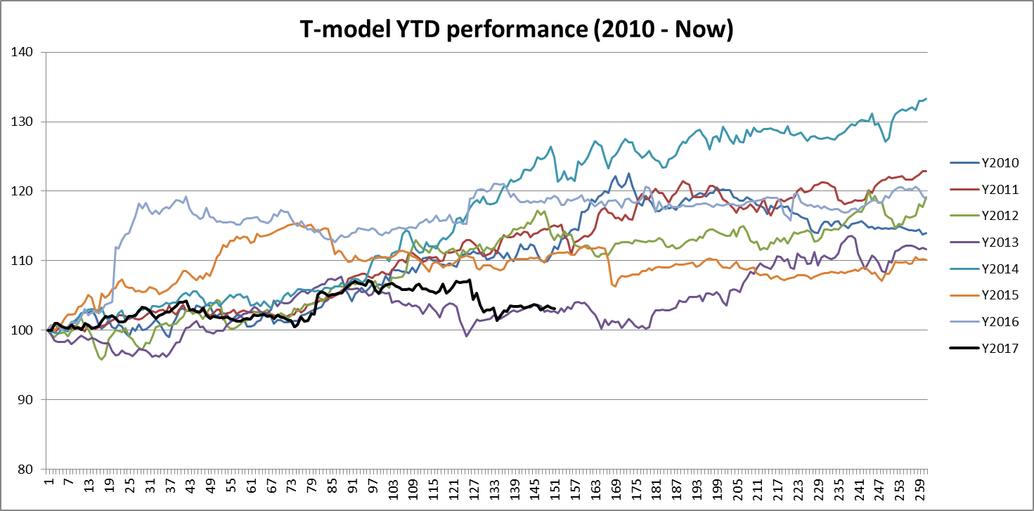
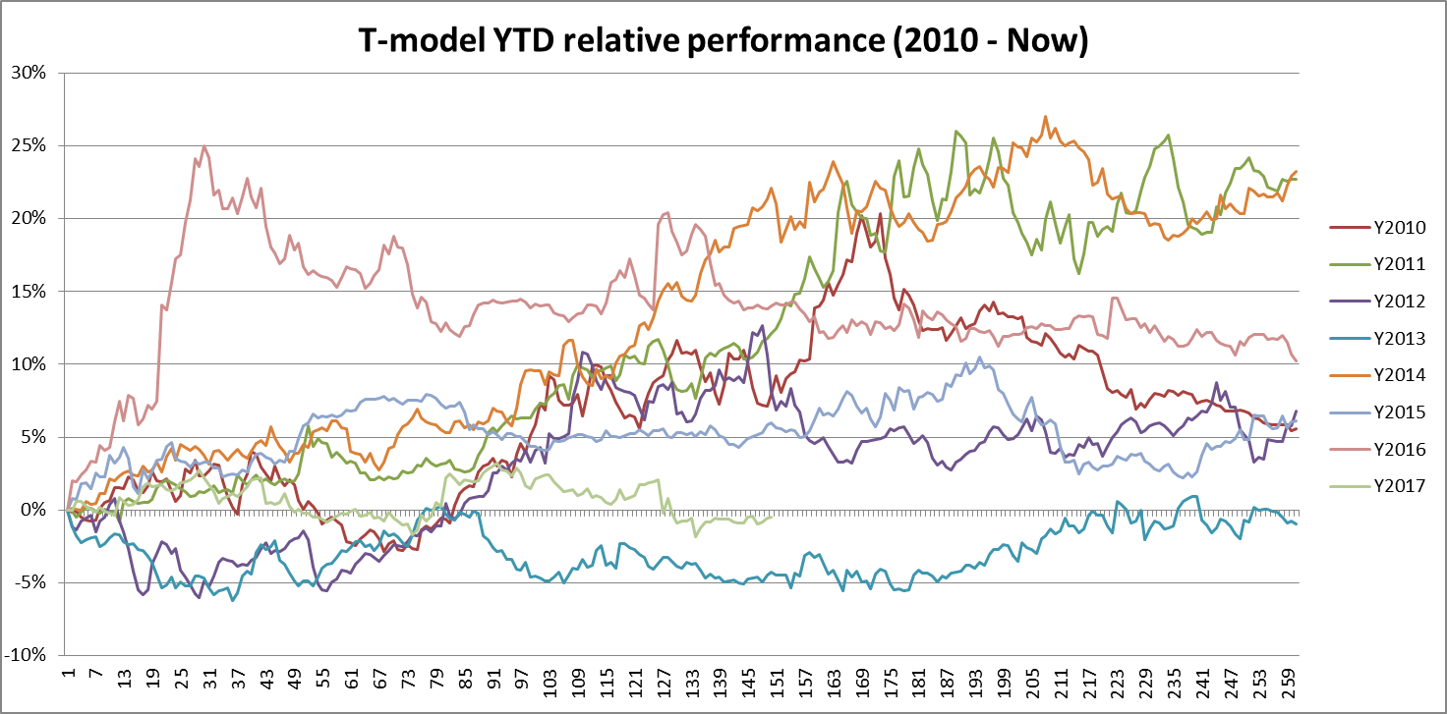
Result – details

Slide 21
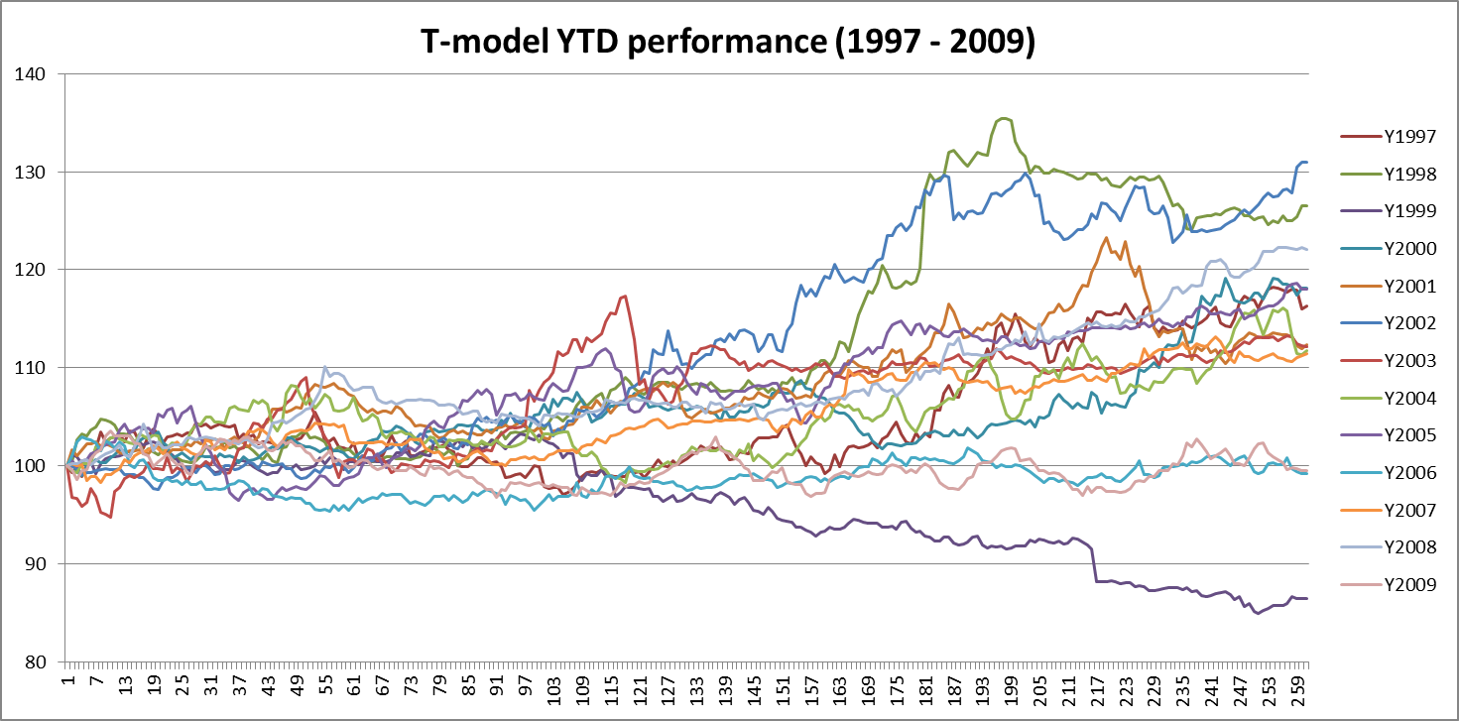
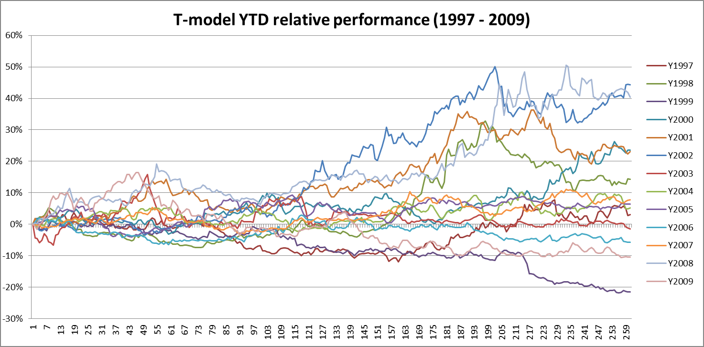
Result – details

